Slide 1
What you have done so far
Working with Linux/command line
Learn to use the cluster (Germán & Malick)
Assess quality of Illumina reads and trim
Assemble reads into contigs
Lectures:
Fermented foods and microbial ecology/evolution
Illumina sequencing and other NGS technologies
Principles of genome assembly

Slide 2
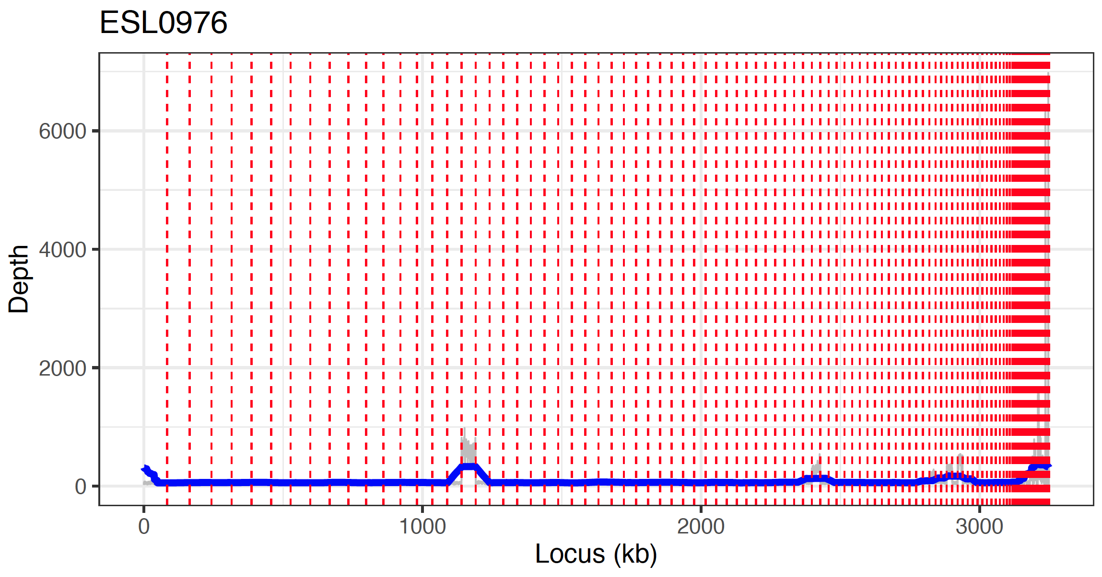
Mapping reads to assembly

Slide 3
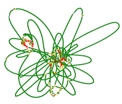
Wrap up
-
Illumina Genome Assembly
Philipp Engel 11.10.2022

Slide 4
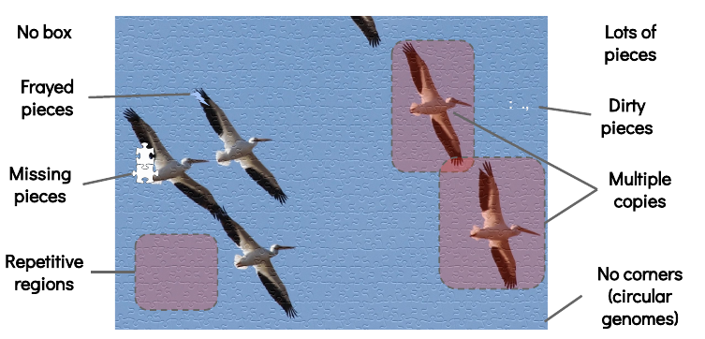
Major challenges for genome assemblies
Illumina = puzzle with 1000 pieces → ONT = puzzle with 10 pieces
🚨 🐝🚨Repeats is the number one reason for why assemblies break!

Slide 5
Illumina and the repeat problem 1
Tandem repeat
copy number = 6
Chromosomal
organization
Read length matters!
de Brujin graph
6x
Possible assembly solutions
Solution 1 → Contig 1
Solution 2 → Contig 1
Solution 3 → Contig 1
Conservative solution
3 contigs
Contig 1
Contig 2
Contig 3

Slide 6
Illumina and the repeat problem 2
Genome-wide repeat
copy number = 2
Chromosomal
organization
region1
region2
region3
region2
de Brujin graph
Most repeats much more complex....
region1
region3
repeat
Possible assembly solutions
Solution 1 → 2 contigs
region2
region1
region3
Solution 2 → 1 contig
region1
region2
region3
Conservative solution
4 contigs
region1
repeat
region2
region3

Slide 7
Draft genome or fully assembled genome?
Our Illumina genome assembly = Draft genome
Draft genome → several contigs with gaps in-between
Complete genome → one contig (or several contigs) without gaps
Option 1:
Option 2:
Illumina draft genomes
Nanopore/PacBio sequencing
Published genomes:
286’625 genomes
Complete genomes:
20’714
Complete genome
Genome annotation
Genome annotation
Genome analysis
Genome analysis
https://www.ncbi.nlm.nih.gov/genome/browse#!/prokaryotes/
Publication
Publication

Slide 8
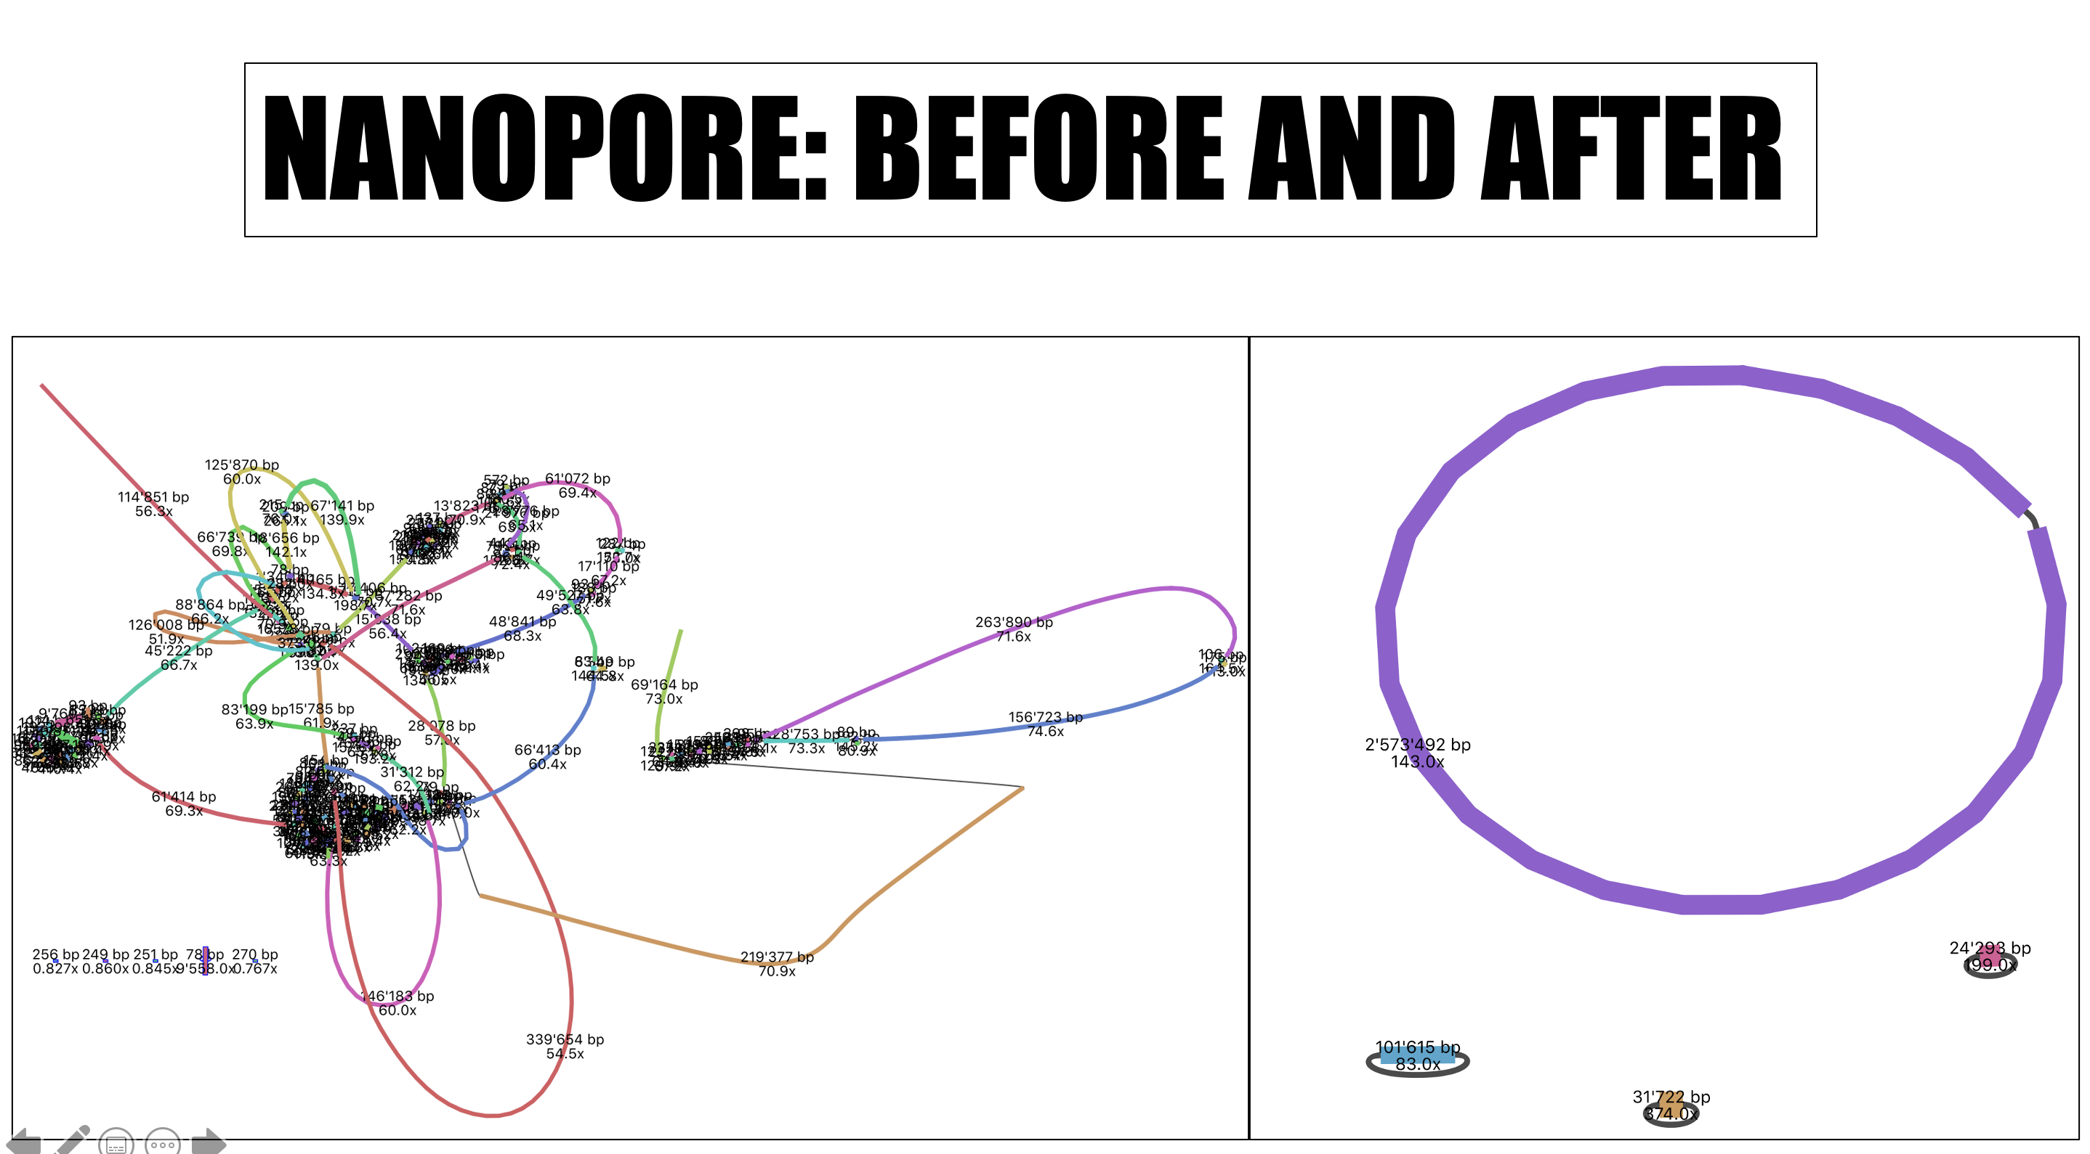
From draft to complete genomes...
Illumina assembly
ONT/PacBio assembly
Many contigs
Not clear how connected
One contig per circular replicon
Chromosome and plasmids

Slide 9
Advantages of completely assembled genomes
No assembly gaps
No missing genes
No gene fragments
chromosome
contig 1
contig 2
gap

Slide 10
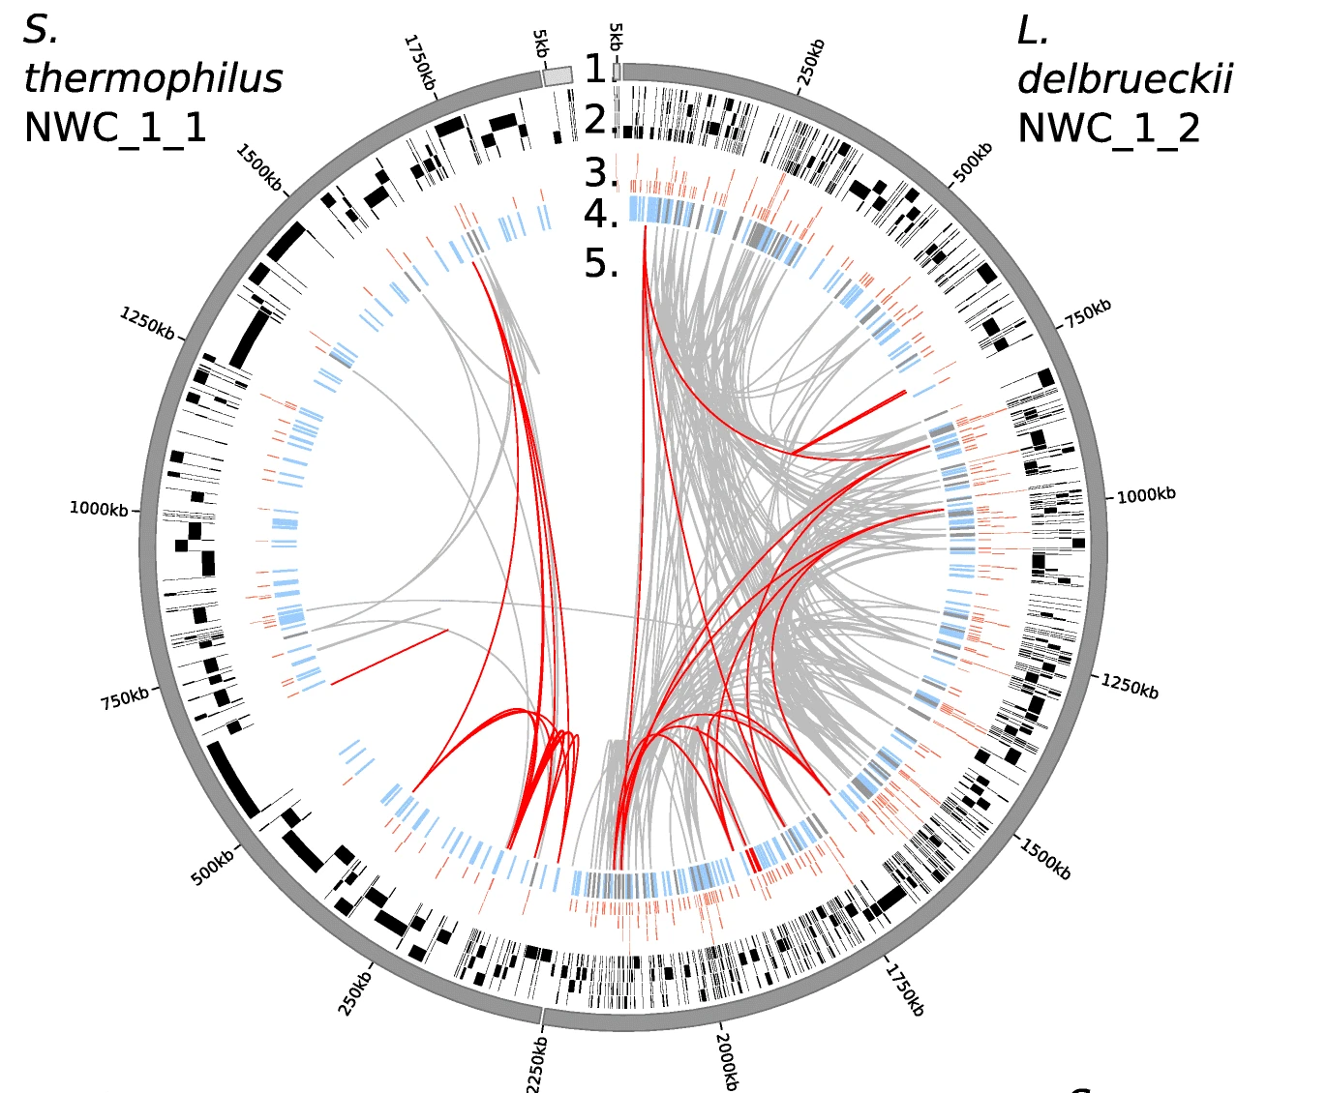
Advantages of completely assembled genomes
No assembly gaps
No missing genes
No gene fragments
No collapsed repeat regions
correct copy number of genes
chromosome
16S rRNA gene copies
Reference genome
Illumina contigs
3 & 4. Missing genes
5. Repeated regions
contig 1
contig 2
contig 3
contig 4
contig 5

Slide 11
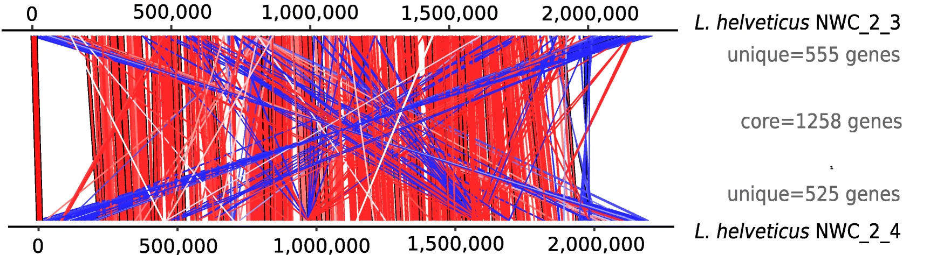
Advantages of completely assembled genomes
No assembly gaps
No missing genes
No gene fragments
No collapsed repeat regions
correct copy number of genes
Genomic structures can be compared

Slide 12
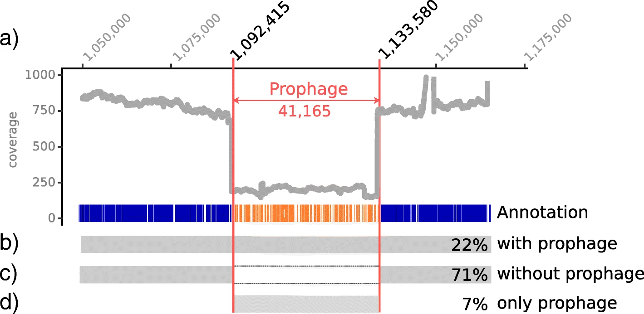
Advantages of completely assembled genomes
No assembly gaps
No missing genes
No gene fragments
No collapsed repeat regions
correct copy number of genes
Genomic structures can be compared
Genomic context of genes

Slide 13
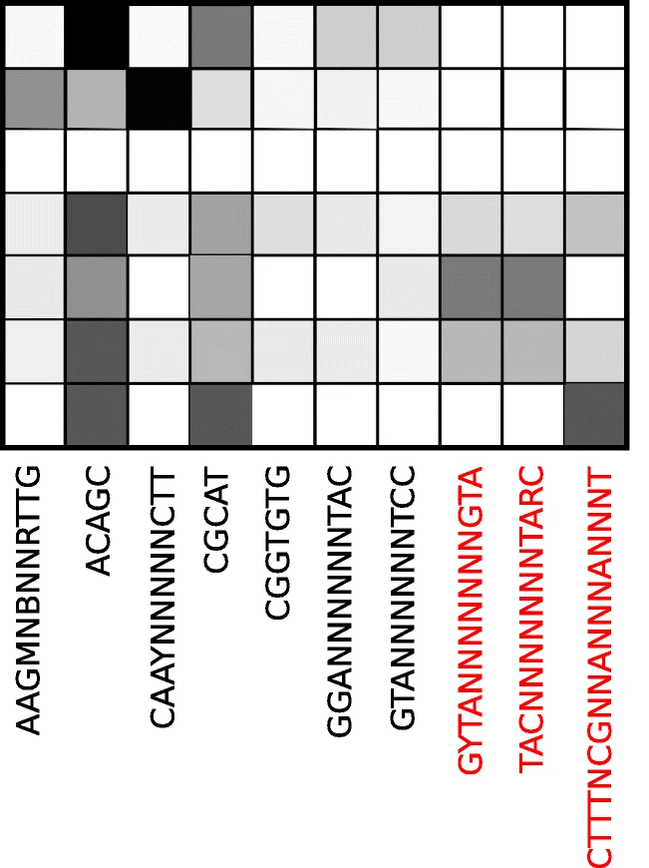
Advantages of completely assembled genomes
No assembly gaps
No missing genes
No gene fragments
No collapsed repeat regions
correct copy number of genes
Genomic structures can be compared
Genomic context of genes
Detection of DNA methylation

Slide 14
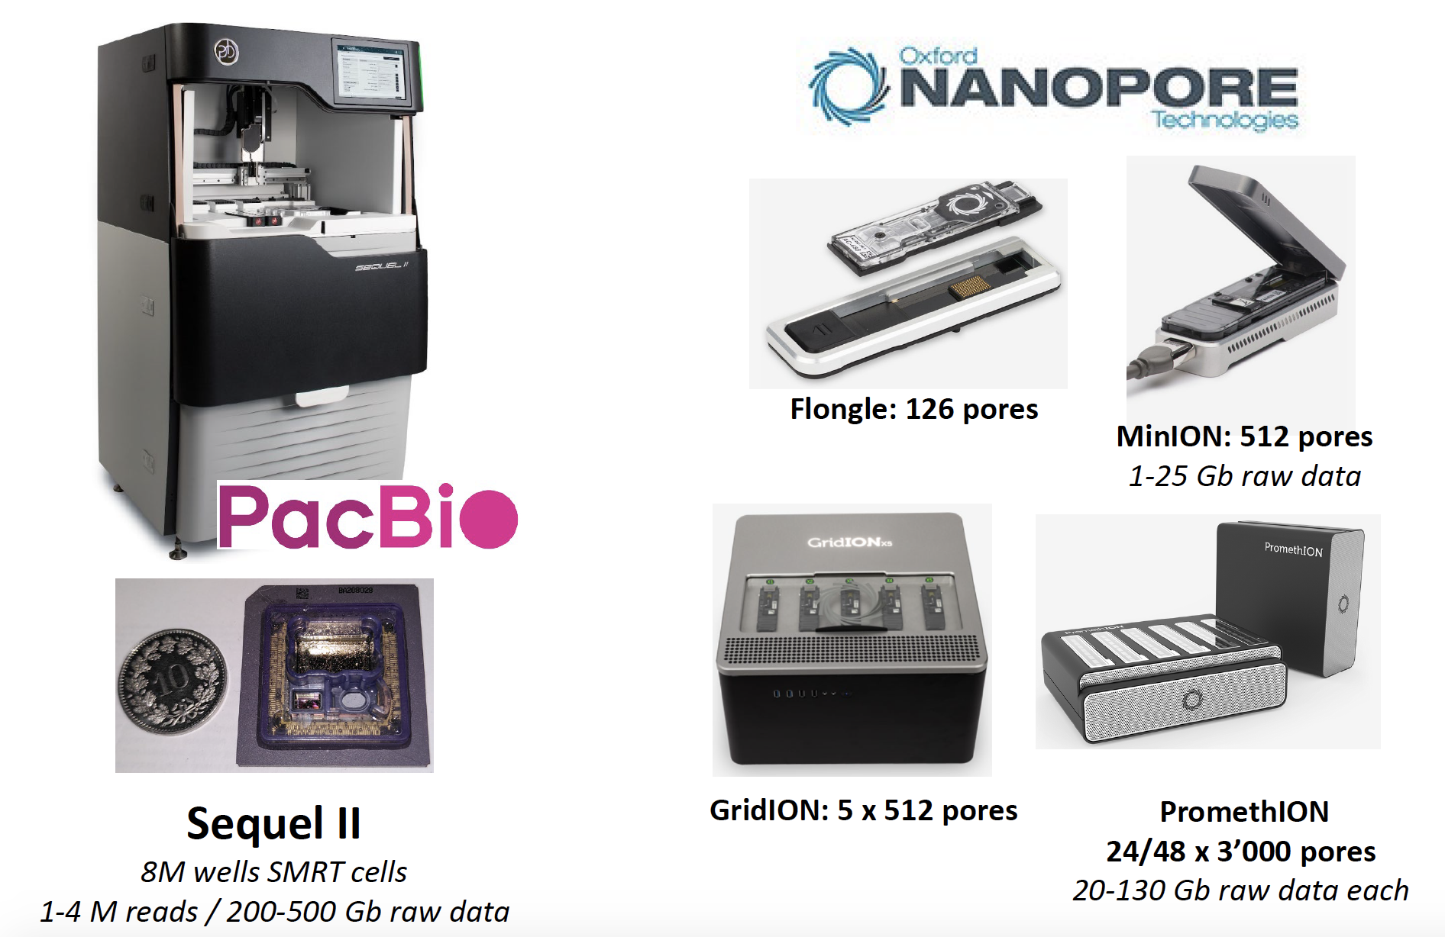
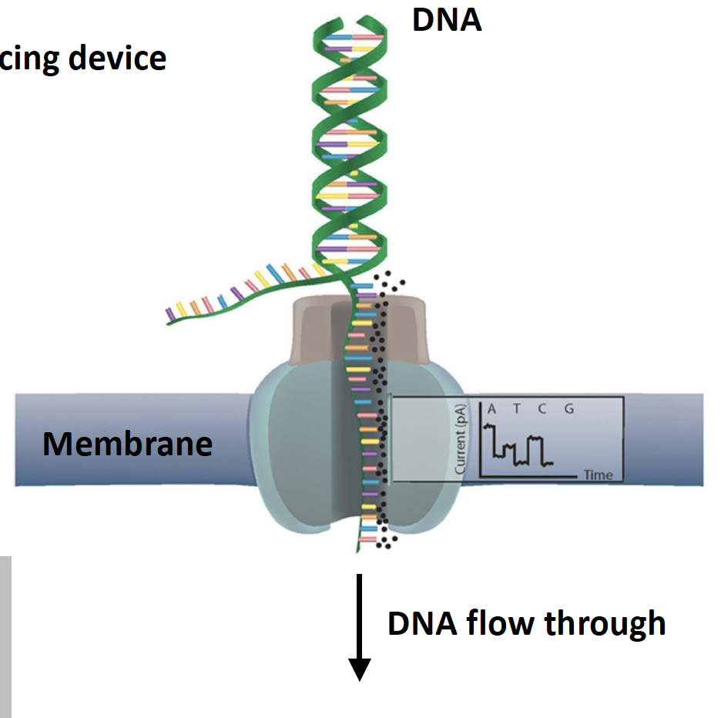
We will use Oxford Nanopore sequencing

